Slide 1
ENGINEERING GRAPHICS
Topic:
Letter Writing

Slide 2
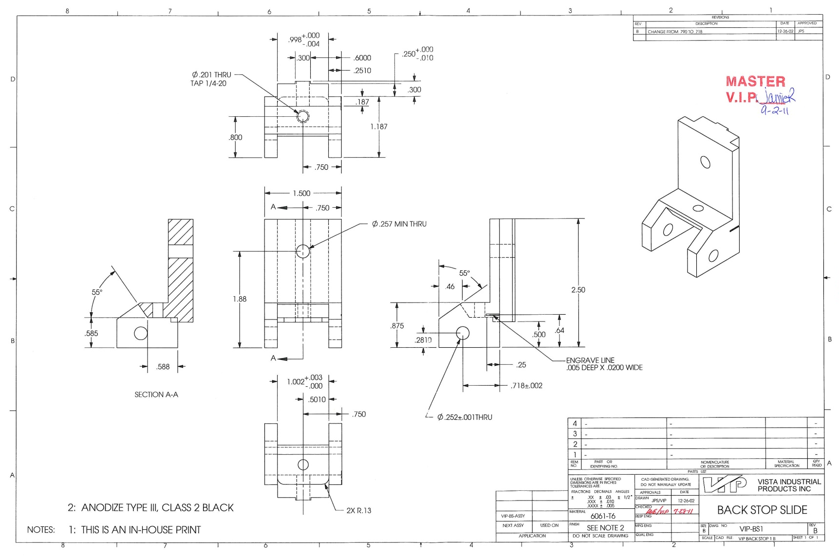
Letter Writing

Slide 3
Letter Writing
The written information on the drawings should be legible, neat in appearance and correct in style.
So, all written information on the drawing is always in the form of lettering and not in handwriting.
Letter writing is an art of writing text on a drawing by using alphabets, numerals and symbols.

Slide 4
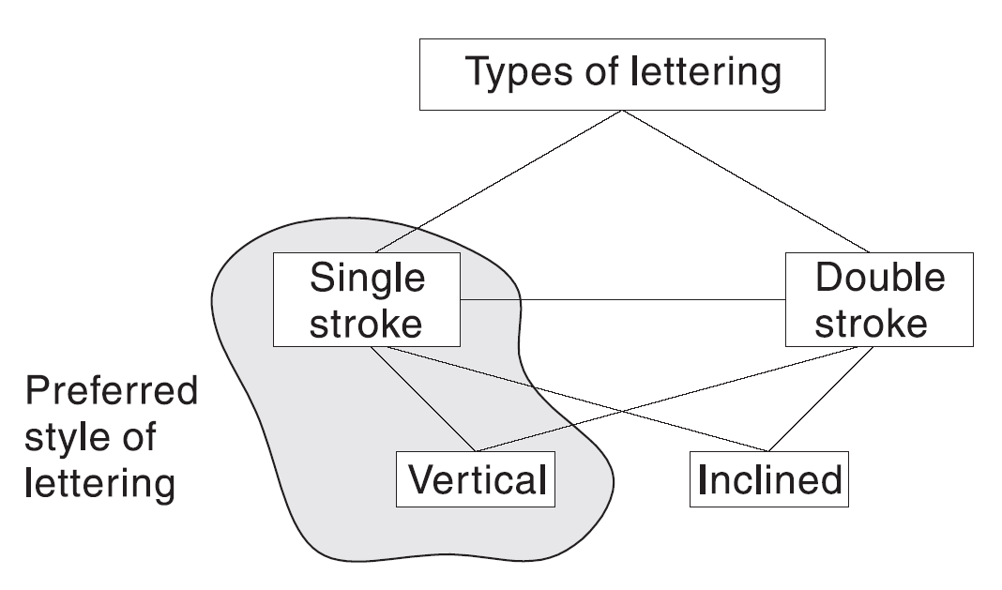
Letter Writing
Types of letter writing —
Single stroke.
Double stroke.

Slide 5
Gothic Letters
Single stroke letters are legible, neat in appearance and correct in style, therefore they are universally used for engineering drawings.
Letters having all strokes of uniform thickness are classified as Gothic.
The style of the letter, when the thickness of the strokes is such that it can be made with a single stroke of pencil, is called Single Stroke Gothic.

Slide 6
Gothic Letters
Single stroke vertical letters:
Letters are designated by their height.
The ratio of height to width for single strike vertical gothic letters is given below.
SR. | HEIGHT TO WIDTH RATIO | LETTER/NUMERAL
1. | 7:5 | All letters except I, J, L, M, W
2. | 7:4 | All numerals except 1
3. | 7:1 | I
4. | 7:3 | 1
5. | 7:4 | L & J
6. | 7:6 | M
7. | 7:8 | W

Slide 7
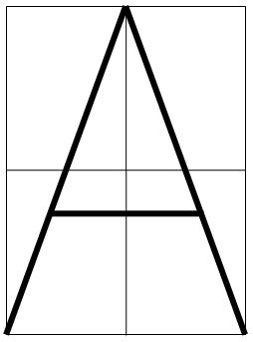
Gothic Letters

Slide 8
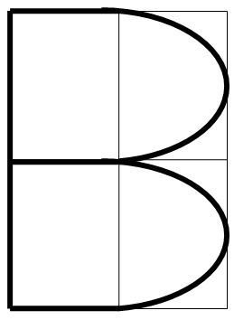
Gothic Letters

Slide 9
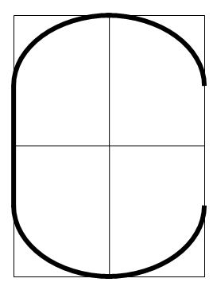
Gothic Letters

Slide 10
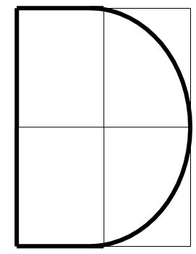
Gothic Letters

Slide 11
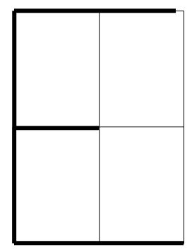
Gothic Letters

Slide 12
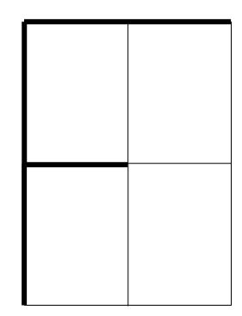
Gothic Letters

Slide 13
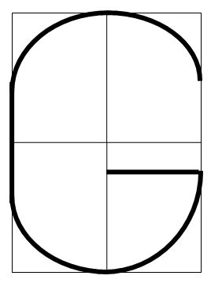
Gothic Letters

Slide 14
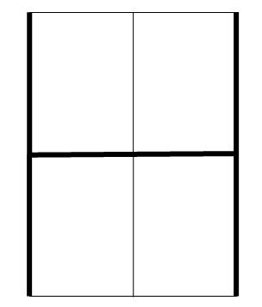
Gothic Letters

Slide 15
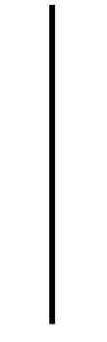
Gothic Letters

Slide 16
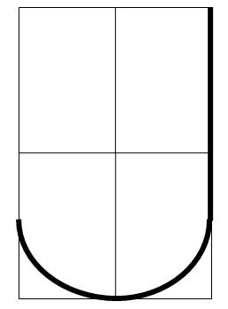
Gothic Letters

Slide 17
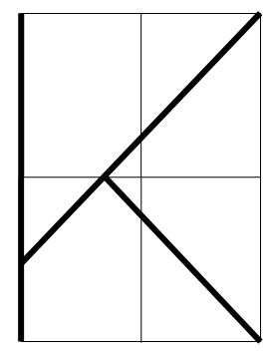
Gothic Letters

Slide 18
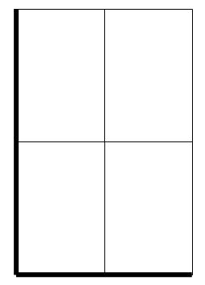
Gothic Letters

Slide 19
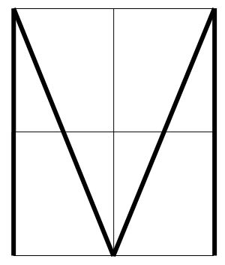
Gothic Letters

Slide 20
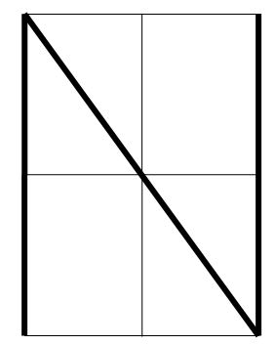
Gothic Letters

Slide 21
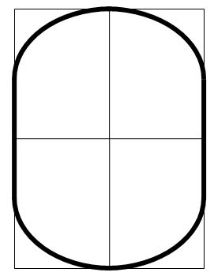
Gothic Letters

Slide 22
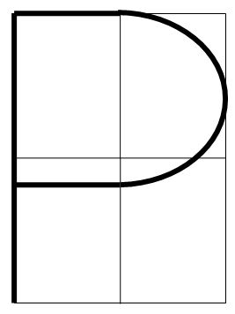
Gothic Letters

Slide 23
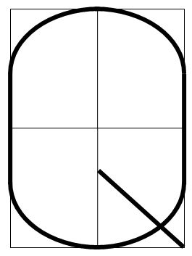
Gothic Letters

Slide 24
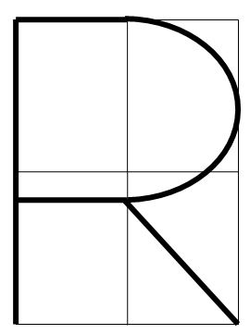
Gothic Letters

Slide 25
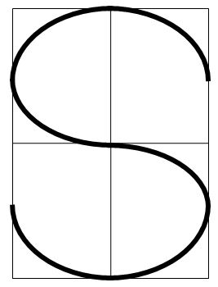
Gothic Letters

Slide 26
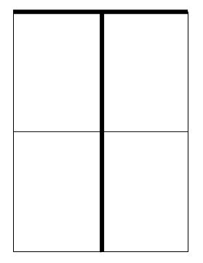
Gothic Letters

Slide 27
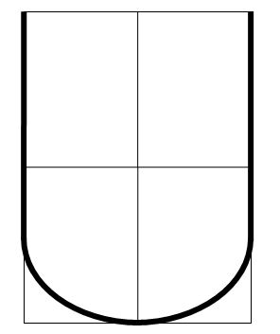
Gothic Letters

Slide 28
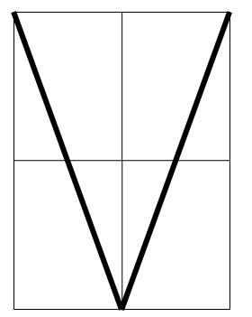
Gothic Letters

Slide 29
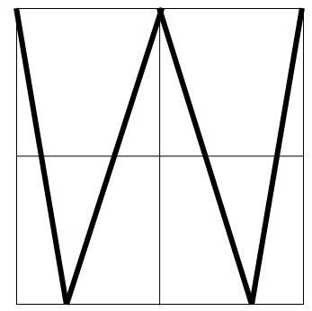
Gothic Letters

Slide 30
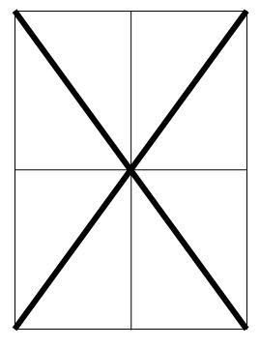
Gothic Letters

Slide 31
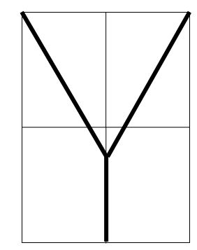
Gothic Letters

Slide 32
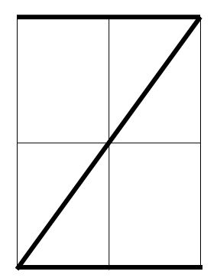
Gothic Letters

Slide 33
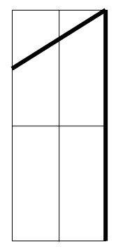
Gothic Letters

Slide 34
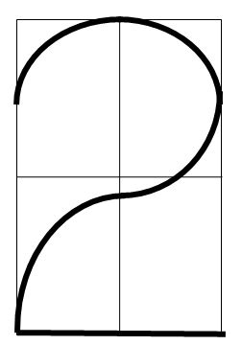
Gothic Letters

Slide 35
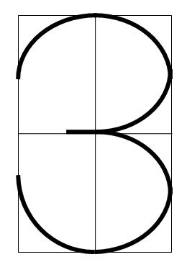
Gothic Letters

Slide 36
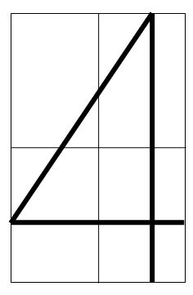
Gothic Letters

Slide 37
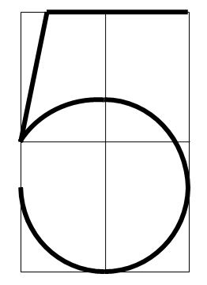
Gothic Letters

Slide 38
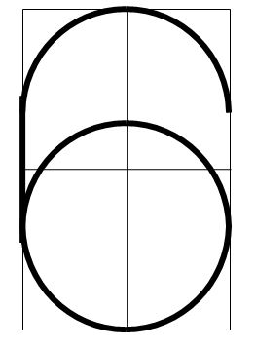
Gothic Letters

Slide 39
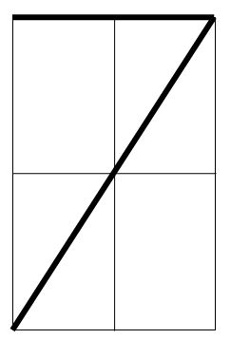
Gothic Letters

Slide 40
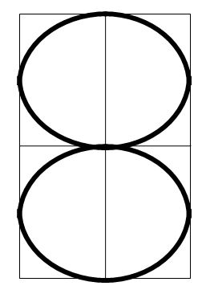
Gothic Letters

Slide 41
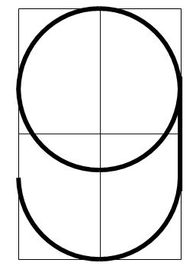
Gothic Letters

Slide 42
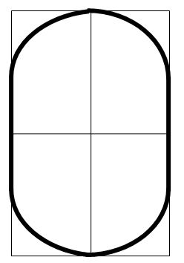
Gothic Letters

Slide 43
Rules of Letter Writing
The height of all the letters in one line should be the same.
The gap between two letters in a word should be 2 mm.
Words should be spaced one letter width apart and distance between two lines is equal to height of one letter.
They should appear upright from Bottom Edge, except when they are used for dimensioning.
Round-off the sharp corners wherever necessary, e.g., D, P, S, etc.
Letters and numerals are designated by their heights.

Slide 44
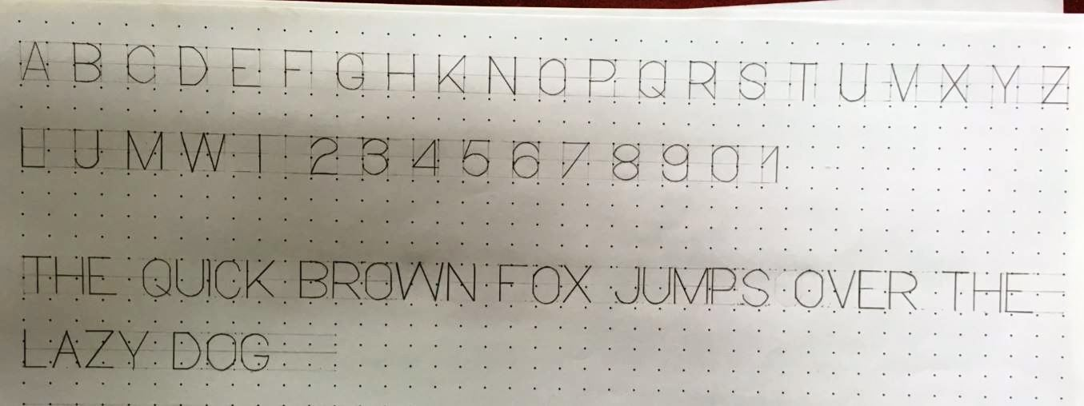

Slide 45
Thanks

